Slide 1
Flame Tests

Slide 2
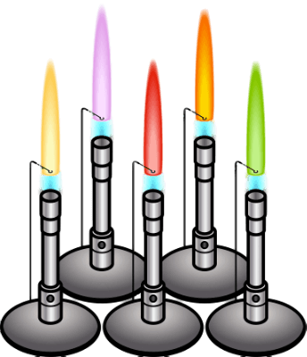
In this Smart Lesson you will learn about a simple analytical technique used to identify certain elements, called a flame test.

Slide 3

Have you ever wondered how fireworks produce so many different colours? By packing the firework pellets with different colour producing chemicals, you can create a rainbow of colours.
Some chemicals burn with a coloured flame, and this is the basis of fireworks and of the flame test.

Slide 4
Flame tests are most commonly used to identify metal cations.
When heated in a flame, the electrons are excited to a higher orbital. They then drop back to the lower orbital, and in doing so they give off light. The amount of energy, and hence emission spectrum, is specific to each element. This means that different elements produce different coloured flames.

Slide 5
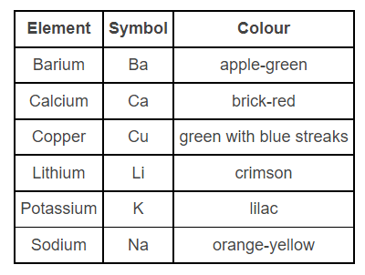
Some examples of characteristic flame test colours are shown in the table below:

Slide 6
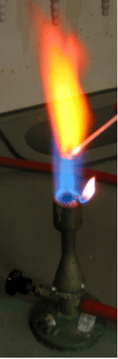
So how can you actually carry out a flame test?
There are several methods used. One of the easiest is to soak a paddle pop stick in water overnight, then dip it in a solution of the substance you wish to test, then hold the stick in a bunsen flame and observe the colour of the flame. Just make sure you don't set the stick on fire!

Slide 7
Another common method used, which is especially useful for insoluble salts, is to burn a sample on a nichrome or platinum wire.
To do this, first the wire is cleaned, then dipped in water and then into the test solid. Crystals will stick onto the wire. This is then burned in the bunsen flame.

Slide 8
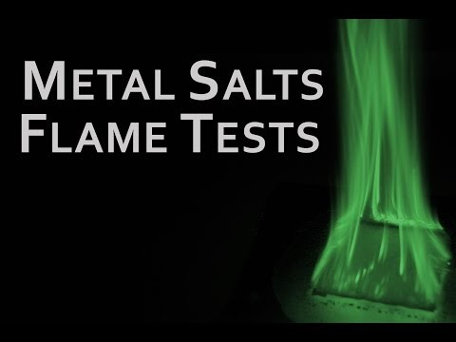

Slide 9
Another version of the flame test is done by dissolving the metal salts in ethanol in a plastic spray bottle. The solution is then sprayed into the flame. It produces a good effect, but can be very messy. Make sure you are aware of all risks before attempting this experiment!

Slide 10


